Slide 1


Slide 2
Solution focused brief therapy
Response Solution-focused brief therapy is a type of therapy that helps a person under the current and future circumstances and goals. Still, it does not rely on past experiences. In this therapy, the problems that make the client visit a therapist are not tackled, but the therapist helps the clients envision the future and look for proper ways to become successful (Selekman, 2006).
It involves helping the clients identify and develop skills that can help them achieve a vision set.

Slide 3
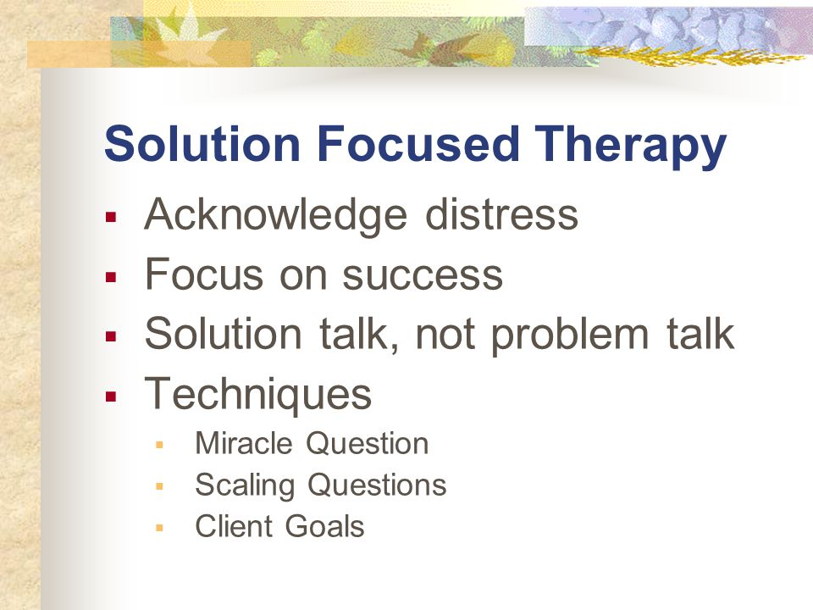

Slide 4
Strength finders
It involves helping the clients identify and develop skills that can help them achieve strength finders is the best activity that can be used in the solution focus based therapy of a group of five grandparents trying to raise their grandchildren because their children are drug addicts (Selekman, 2006). Strength finders' activity can help the five individuals find a proper way of raising their grandchildren by finding their strength and motivation that makes them achieve the best.

Slide 5
The progress made in the therapy
The progress of the therapy was established by describing the feeling of the grandchildren they were supporting. Most of them felt that they were doing the right thing for their grandchildren's better future (O'Connell, 2012). They did not feel stressed in helping the grandchildren to have a successful future. The progress was also measured by the consistency in attending the therapy sections since they attended most sections. The grandparents' confidence, motivation, and hopefulness in raising their grandchildren helped to show the progress they had undertaken in the therapy.

Slide 6
The material used in the strength finders activity
Materials that will be used in strength finding activities will be papers for the questionnaire. They will be used to help the five grandparents identify their strengths through the guidance of the questions. Pens are used for writing the answers. Another activity to find the grandparents' strength will be through games in that every patient will lead a group in doing a simple game.

Slide 7
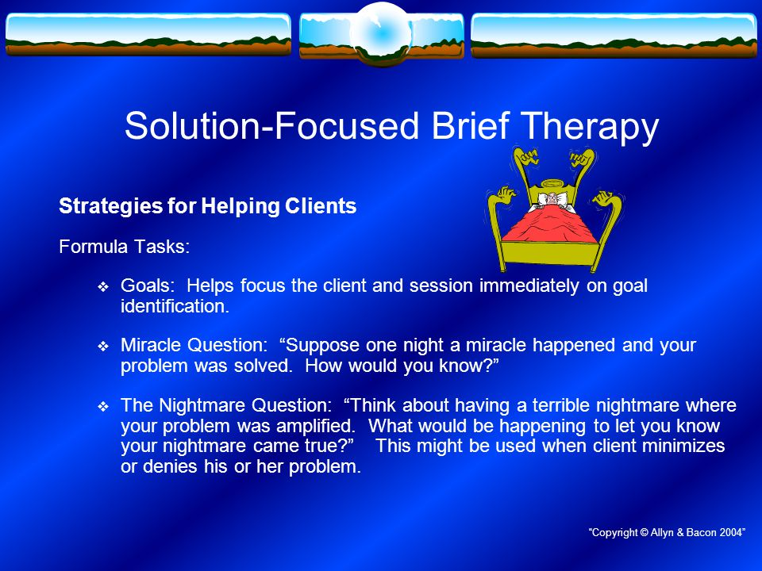

Slide 8
The purpose of the activity
The strength finder activity, such as filling the questionnaires, helps the patients realize what they are useful in or not. This helps the therapists to identify strengths other strengths of the patients that may not come under the regular therapy sections (O'Connell, 2012). The strength found can help to identify ways for achieving their visions.

Slide 9
The purpose of the activity
Allowing the patients to lead others in simple games helps the therapist identify the patients' strength, which can be used to encourage them when they are giving up (Elliott and Kim, 2013). Leading other people for a small exercise needs patient, creativity, courage, and passion; this attribute, when identified, can be used to help the grandparents raise their grandchildren without more trouble.

Slide 10
The time frame of the activities.
Answering questionnaires can take three to five minutes; the questionnaires should be short and precise to enable the grandparents to answer fast without problems (Franklin et al., 2012). Every individual leading the group in a simple exercise will take twenty minutes, a break, and a bonding section.

Slide 11
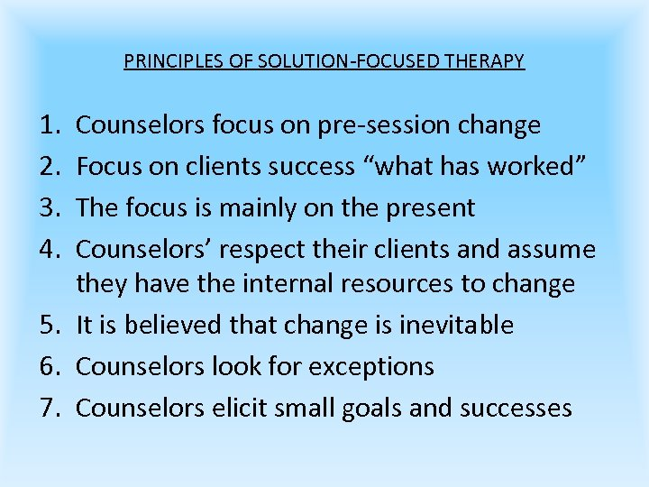

Slide 12
Activity discussion
Strength finders activities such as answering the questionnaire are significant in solution-focused based therapy because they help to measure the patients' progress. If the grandparents were unhappy with raising their grandchildren and in the questionnaire, they like parts of things the children do; it is a progress that can be worked on. They help find motivation and confidence in the patients (Franklin et al., 2012).

Slide 13
Activity discussion
Strength finders activity can also be carried out in solution focus-based therapy by allowing the patients to lead others in a set of small exercises such as singing or stretching (Franklin et al., 2012). It helps the therapist and the individuals realize their capabilities and talents, which can be a tool for working on the patients' goals. It also helps the group bond so that they don't fear talking in the therapy sections.

Slide 14
Measure of the progress of the individuals
The progress in the solution-focused therapist is the confidence of the patients in succeeding—the level of hopefulness and motivation in achieving the goals sets.
Problem solving
Think on the solution of your problems | How do you feel while helping your grandchildren | Do you feel you can give your grandchildren better lives despite failing on your own children | Do you think your grandchildren have a promising future | What are you going to do to help your grandchildren

Slide 15

References
Elliott, W., & Kim, J. S. (2013). The role of identity-based motivation and solution-focus brief therapy in unifying accounts and financial education in school-related CDA programs. Children and Youth Services Review, 35(3), 402-410.
Franklin, C., Trepper, T. S., McCollum, E. E., & Gingerich, W. J. (Eds.). (2012). Solution-focused brief therapy: A handbook of evidence-based practice. Oxford University Press.
O'Connell, B. (2012). Solution-focused therapy. Sage.
Selekman, M. D. (2006). Working with self-harming adolescents: A collaborative, strengths-based therapy approach. WW Norton & Co.

